Slide 1
Midterm Review &
Project 6 Overview
Midterm Topics Brainstorm, Midterm Practice Problems, Project 6 Overview, Hack CPU Logic Exercise

Slide 2
Lecture Outline
Midterm Topics Brainstorm
  Starting a Study Plan for Exams
CSE 390B Midterm Practice Problems
  Circuit Design, Writing Assembly, Tracing Assembly
Project 6 Overview
  Project Tips and Workflow
Hack CPU Logic Example: writeM
  Project 6 CPU Logic Exercise

Slide 3
CSE 390B Midterm Topics Brainstorm
Based on what we have covered thus far in class, what are topics, concepts, questions that you might expect to show up on next week’s CSE 390B midterm?

Slide 4
Lecture Outline
Midterm Topics Brainstorm
  Starting a Study Plan for Exams
CSE 390B Midterm Practice Problems
  Circuit Design, Writing Assembly, Tracing Assembly
Project 6 Overview
  Project Tips and Workflow
Hack CPU Logic Example: writeM
  Project 6 CPU Logic Exercise

Slide 5
CSE 390B Review Session
Step 1: Work on the problem individually for ten minutes
Step 2: Discuss in groups your problem-solving approach
Step 3: Discuss tips for approaching this exam problem and write it on the whiteboard
Step 4: Identify two people in your group to walk through the problem and present tips for solving the problem

Slide 6
Review Session Debrief
Based on your experience with this exercise, how does it inform how you approach your studying?
What resources can you utilize to help you deepen your understanding?

Slide 7
Previous CSE 390B Midterms
Four midterms from previous quarters
  20sp midterm likely more difficult than midterm this quarter
  Midterm from 21wi, 21sp, and 22wi are more similar to what this quarter’s midterm will look like
20sp midterm recommended to become familiar with problem types
21wi, 21sp, and 22wi midterms recommended for practicing a timed exam
  Set a timer for 50 minutes and take the exam in its entirety
  Helps practice time management and simulate exam environment

Slide 8
Lecture Outline
Midterm Topics Brainstorm
  Starting a Study Plan for Exams
CSE 390B Midterm Practice Problems
  Circuit Design, Writing Assembly, Tracing Assembly
Project 6 Overview
  Project Tips and Workflow
Hack CPU Logic Example: writeM
  Project 6 CPU Logic Exercise

Slide 9
Project 6: Overview
Part I: Mock Exam Problem
Part II: Building a Computer
  LoadAReg.hdl, LoadDReg.hdl (Easier)
  JumpLogic.hdl (Medium)
  CPU.hdl (Harder)
  Computer.hdl (Easier)
Part III: Project 6 Reflection

Slide 10
Project 6, Part I: Mock Exam Problem
Your group will meet for a 30-minute session to do one mock exam problem
  Your group’s mock exam problem will be emailed right before your session
Your 30-minute session will include:
  Set up: 5 minutes
  Mock Exam Problem: 10 minutes
  Debrief & Reflection: 15 minutes
Part I Task: Submit the completed mock exam problem and complete the reflection questions

Slide 11
Project 6 Tips
CPU.hdl: We provide an overview diagram, but there are details to fill in, especially control
  Draw your own detailed diagram first
  Handling jumps will require a lot of logic—sketch out the cases
  Textbook chapter 4 and 5 helpful for Project 6
Multi-Bit Buses: MSB to the left, LSB to the right
  Important to keep in mind when taking apart the instruction
Debugging: Consult .out and .cmp files to debug, then look at internal wires in simulator
  See also the “Debugging tips” section of the specification

Slide 12
Hack CPU Logic
How do we determine the unimplemented logic for the CPU (all of the c’s in the diagrams)?
Refer to the assembly specification
Project 6 will requires understanding of textbook chapters to determine how to use the instruction bits to implement the control logic
  Helpful textbook sections: 4.2.2, 4.2.3, and 5.3.1

Slide 13
Hack CPU Logic Workflow
Step 1: What do we pay attention to?
  Usually, will be some combination of instruction bits or intermediate outputs
  These are the “inputs” to your sub-problem
Step 2: Determine logic for the part you are working on
  Uses the “inputs” from Step 1
  Usually requires reading a relevant section of the textbook or assembly specification

Slide 14
Lecture Outline
Midterm Topics Brainstorm
  Starting a Study Plan for Exams
CSE 390B Midterm Practice Problems
  Circuit Design, Writing Assembly, Tracing Assembly
Project 6 Overview
  Project Tips and Workflow
Hack CPU Logic Example: writeM
  Project 6 CPU Logic Exercise

Slide 15
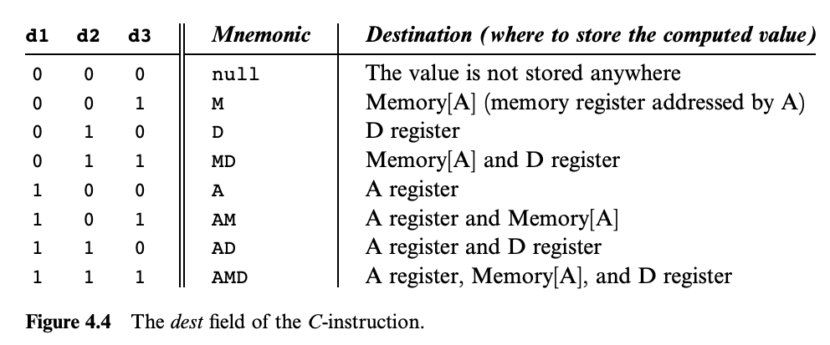
Hack CPU Logic Example: writeM
Example: Determine when writeM should be set to 1
Step 1: What do we pay attention to?
  writeM is related to whether we write to memory or not
  We need to look up the destination bits specification from Chapter 4

Slide 16
Hack CPU Logic Example: writeM
Example: Determine when writeM should be set to 1
Step 2: Determine logic for specification
  Read the “Destination Specification” section of Chapter 4
  Instruction bits:
  1 1 1 a c1 c2 c3 c4 c5 c6 d1 d2 d3 j1 j2 j3

Slide 17
Hack CPU Implementation: Logic Sub Chips
We provide three sub chips and tests that implement the control logic for the A Register, D Register, and PC
  LoadAReg contains logic for loading the A Register
  LoadDReg contains logic for loading the D Register
  JumpLogic contains logic for determining if the PC should load, jump, or increment
Implement and test these first, then use them in your CPU implementation
  Intended to help you narrow the scope of bugs

Slide 18
Lecture 10 Wrap-up
Crossing the mid-quarter bridge to Week 6!
  Metacognitive Subject: Exam-Taking Strategies
  Technical Subject: Review of Technical Subjects
CSE 390B Midterm next Thursday (5/5) during lecture
Project Reminders
  Project 4 grades and feedback released on Gradescope
  Project 5 due tonight (4/28) at 11:59pm PDT
  Project 6 (Mock Exam Problem & Building a Computer) released, due in two weeks on Thursday (5/12) at 11:59pm PDT

